Slide 1
Python API development Seminar Lahore Leads Uni
By
Adnan Majeed
Lecturer CS

Slide 2
Tools required for setup in laptop
Visual studio code
Python installed and environment variable setup
MySQL server
SQL Yog
Post Man for API testing

Slide 3
Database (review) in SQL Yog
CREATE DATABASE mydb;
USE mydb;
CREATE TABLE student(
id INT PRIMARY KEY,
NAME VARCHAR(50),
age INT
);
INSERT INTO student(id, NAME, age)
VALUES(1,'ahmed', 18),
(2, 'ali', 18),
(3,'imran',20);
SELECT * FROM student

Slide 4
Python virtual environment
Open CMD
Select computer disk drives
Type command
Python –m venv ven
Cd ven
Cd scripts
Activate virtual environment
Activate

Slide 5
Install DJANGO & DjangoRestFramework
pip install django djangorestframework
django-admin startproject myproject
cd myproject
python manage.py startapp students

Slide 6
Open myproject in VSCODE
Now open the myproject folder in Vscode for development
Now activate python shell
And create models.py
Create. Serializers.py
Create views.py
Create urls.py
Create main project url

Slide 7
Install API in project setting
Rest_framework
Students

Slide 8
MODELS.PY
from django.db import models
# Create your models here.
class Student(models.Model):
name=models.CharField(max_length=100)
age=models.IntegerField()
course=models.CharField(max_length=100)
def __str__(self):
return self.name

Slide 9
Serializers.py
from rest_framework import serializers
from .models import Student
class StudentSerializer(serializers.ModelSerializer):
class Meta:
model = Student
fields = '__all__'

Slide 10
Views.py
from rest_framework import viewsets
from .models import Student
from .serializers import StudentSerializer
class StudentViewSet(viewsets.ModelViewSet):
queryset = Student.objects.all()
serializer_class = StudentSerializer

Slide 11
Urls.py
from django.urls import path, include
from rest_framework.routers import DefaultRouter
from .views import StudentViewSet
router = DefaultRouter()
router.register('students', StudentViewSet)
urlpatterns = [
path('', include(router.urls)),
]

Slide 12
Main Project urls.py
from django.urls import path, include
urlpatterns = [
path('api/', include('students.urls')),
]

Slide 13
Database migrations
Python manage.py makemigrations students
Python manage.py migrate
Python manage.py runserver

Slide 14
Open browser to test API
http://127.0.0.1:8000/api/students/

Slide 15
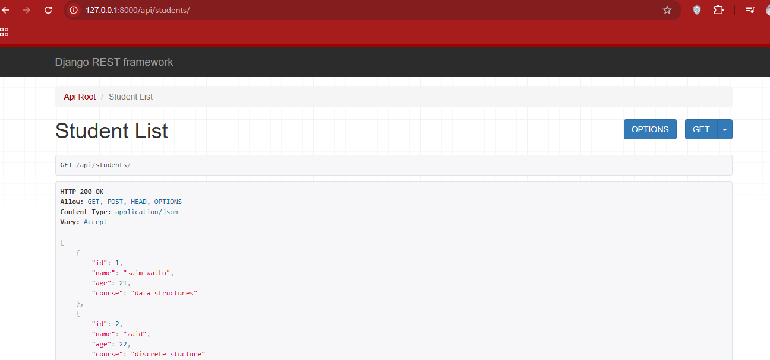
Browser output

Slide 16
Now test API in Postman
Create new collection in POSTMAN
Create the GET method to get all data from API
Create POST method to insert data in API
Now get to test the post request.

Slide 17
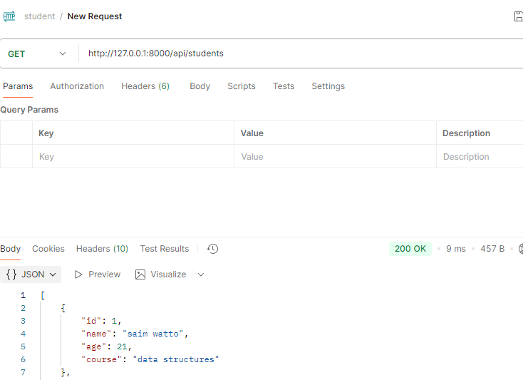

Slide 18
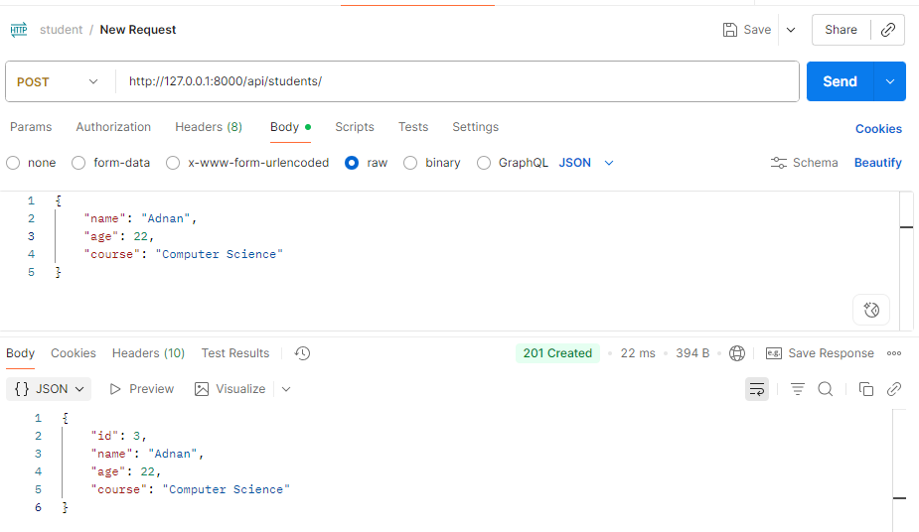

Slide 19
API BENEFITS
One API can work on both Android and iOS platforms
(and even web apps, desktop aps, smart TVs, IoT devices, etc.).

Slide 20
Benefits of Single API for All Platforms
Code Reusability → Backend is written once, not repeated.
Consistency → Data and business logic stay the same across platforms.
Faster Development → Teams only focus on platform-specific UI.
Scalability → Add new platforms (desktop, IoT, smart devices) without changing the backend.

Slide 21
done

